Slide 1

DEEPFAKE VIDEO DETECTION
Using CNN,RNN,LSTM
DEEP LEARNING

Slide 2
ABSTRACT:
In today's era, deep learning-based software tools have made it easier to create convincing face swaps in videos, commonly known as "DeepFake" videos. Deep learning breakthroughs have significantly improved the realism of fake content, making it challenging to detect. This artificial intelligence-generated media (DF) is easily created, but detecting it remains a substantial challenge. We've made progress in DF detection using Convolutional Neural Networks (CNN) and Recurrent Neural Networks (RNN). Our system utilizes a CNN at the frame level to extract features and trains an RNN to identify temporal irregularities introduced by DF tools. Our simple architecture achieves competitive results in this task.

Slide 3
DATA SET:
The dataset used here is mixed with videos of equal numbers from various sources like Face Forensics++ which has fifty percent of the first video and fifty percent of tampered DF videos. Finally, the dataset is made by anappropriate division of thirty percent for test and seventy percent for the train.

Slide 4
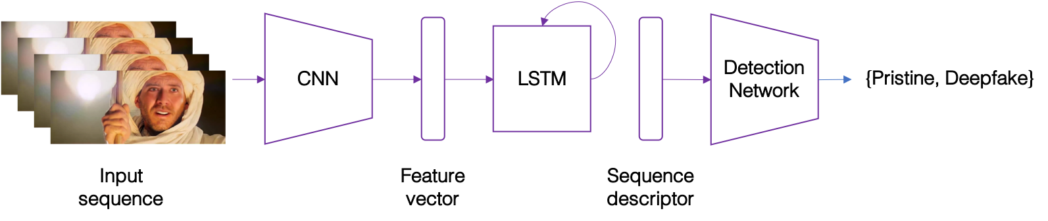
ARCHITECTURE:

Slide 5
Model Description
Model Used:
There are many parameters to consider a single layer of LSTM with resnext50 in the model creation. The DataLoader loads the preprocessed face-cropped videos and divides the videos into a test set and train set. Frames gained after preprocessing of the videos are provided tomodel for testing and training.

Slide 6
Model Description
Feature Extraction using ResNext CNN:
The use of ResNext CNN in our project is to extract the features and accurately getting the frame level features also. Our network is finely tuned by addition of extra layers and then choosing the best rate and precisely converge the model gradient descent. Once the lastpooling layer is completed, feature vector of size 2048-dimensional feature is created and it is used as the inputof LSTM

